Slide 1
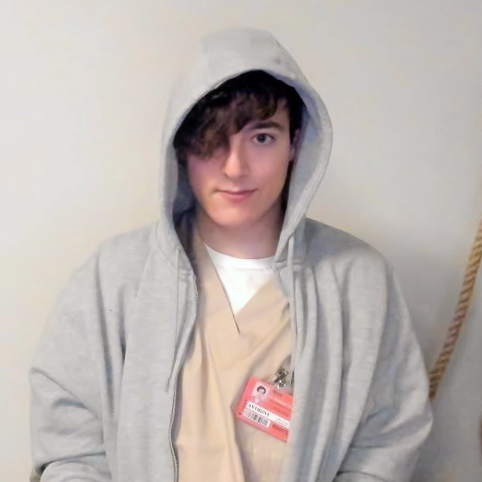



welcome to the games development industry
Fydar
(they/them)
Fydar
Proud Member of the
@Fydarus
IWGB Games Workers
Notes:
Hiya, I’m Fydar.
I’m a former student here at Northbrook!
I studied under Cas and Rob in the same year as Will here.
I remember sitting in those chairs watching these same talks over 6 years ago now.
So… What do I do?

Slide 2
welcome to the games development industry
Fydar
(they/them)
Fydar
Proud Member of the
@Fydarus
IWGB Games Workers
Notes:
So… What do I do?
Well, my current position is as a Senior Tools Engineer at Radical Forge.

Slide 3
Fydar
(they/them)
Fydar
Proud Member of the
@Fydarus
IWGB Games Workers
Tools Engineer
I make the tools that other developers use to make the game.
Notes:
As a Tools Engineer; I make the tools that other developers use to make the game.
- Be that enabling the designers to balance quests and items;
- Or enabling the artists in creating game-ready assets.
- Or just to speed up their workflows more generally.
Being a Tools Engineer is somewhat like being a software developer, but for your in-house developers.

Slide 4
Fydar
(they/them)
Fydar
Proud Member of the
@Fydarus
IWGB Games Workers
Tools Engineer
Infrastructure Engineer
I make the tools that other developers use to make the game.
I make the game servers, databases, and other online services.
Notes:
But I’m also an Infrastructure Engineer.
I do this a lot in me free time.
I love the complex problem solving that making realtime game servers entails. And I love playing multiplayer games so it’s just a win-win.

Slide 5
Fydar
(they/them)
Fydar
Proud Member of the
@Fydarus
IWGB Games Workers
Tools Engineer
Infrastructure Engineer
I make the tools that other developers use to make the game.
I make the game servers, databases, and other online services.
Multiplayer Engineer
I give the other developers the structure that they can utilise to make multiplayer gameplay.
Notes:
And, on the subject of Multiplayer games, I also do some Multiplayer Engineering (along with other systems engineering) alongside the infrastructure engineering.
How did I get here?
Well, as I mentioned earlier, I used to study here. During my last year at Northbrook I started working part-time for…

Slide 6
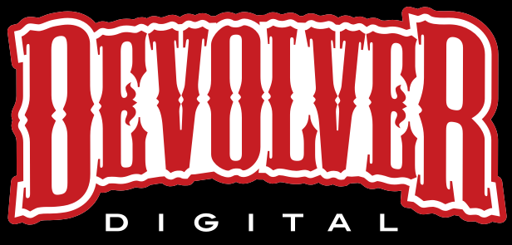
2017
Devolver Digital
12 months (part-time)
5-person team
salary
£18,000
Notes:
During my last year at Northbrook I started working part-time for… Devolver Digital. I was working remotely for a small indie project whilst studying on this very course.
I got this job by searching the Unity job forum. I just showed passion for aspects of Unity programming and the job was mine.
As a passionate member of the IWGB Games Workers Union, I’m a strong believer in pay-transparency. I’m going to be entirely transparent with you about my pay throughout my career.
It’s something that as developers (and as workers) we don’t talk about enough.
Working part-time, my salary was around 18k.

Slide 7

2017
2018
Devolver Digital
12 months (part-time)
5-person team
salary
£18,000
TT Odyssey
2 years, 3 months
30-person studio
salary
£22,000
salary
£36,000
Notes:
From there, I went and joined a AA with TT Games working on a LEGO Star Wars mobile game for little over 2 years.
The studio was a smallish 30-person team in Brighton.
Honestly, I should NOT have accepted the starting salary of £22,000.
It was far too low, and the company was perfectly willing to exploit my lack of confidence and ignorance for as long as possible.
It wasn’t until I threatened to quit that my actual value to the company was revealed, and they made a serious offer. I then started working for £38,000.
If back when I first joined the industry I had the support of a union, I would never have spent over a year getting half the amount of my co-workers with the same title and experience.

Slide 8

2017
2018
2020
Devolver Digital
12 months (part-time)
5-person team
salary
£18,000
TT Odyssey
2 years, 3 months
30-person studio
salary
£22,000
salary
£36,000
Cloud Imperium Games
1 year, 5 months
700-person studio
salary
£45,000
Notes:
From there, I moved on to Cloud Imperium Games.
This was during the pandemic, so I was back to working remotely for such a large studio.

Slide 9

2017
2018
2020
2022
Devolver Digital
12 months (part-time)
5-person team
salary
£18,000
TT Odyssey
2 years, 3 months
30-person studio
salary
£22,000
salary
£36,000
Cloud Imperium Games
1 year, 5 months
700-person studio
salary
£45,000
Hardball Games
3 months
7-person studio
salary
£60,000
Notes:
I then joined Hardball Games. I wouldn’t recommend you work with them.
I explicitly told them during my interview that I would NOT work on an NFT project, and they didn’t respect that.
The studio head started getting interested in NFTs and Blockchain…
I’ve moved on from that phase of my life.

Slide 10

2017
2018
2020
2022
2022
Devolver Digital
12 months (part-time)
5-person team
salary
£18,000
TT Odyssey
2 years, 3 months
30-person studio
salary
£22,000
salary
£36,000
Cloud Imperium Games
1 year, 5 months
700-person studio
salary
£45,000
Hardball Games
3 months
7-person studio
salary
£60,000
Radical Forge
1 year, 5 months
60-person studio
salary
£60,000
Notes:
And finally, I joined Radical Forge. I’m currently working at Radical Forge remotely, we’re a studio based up north in Middlesborough.
I love my coworkers here at Radical Forge. I think some of my best work I have done whilst working at Radical Forge.
As I mentioned, I’m currently a Senior Tools Programmer at Radical Forge, and we’ll see more about what this entails later.

Slide 11
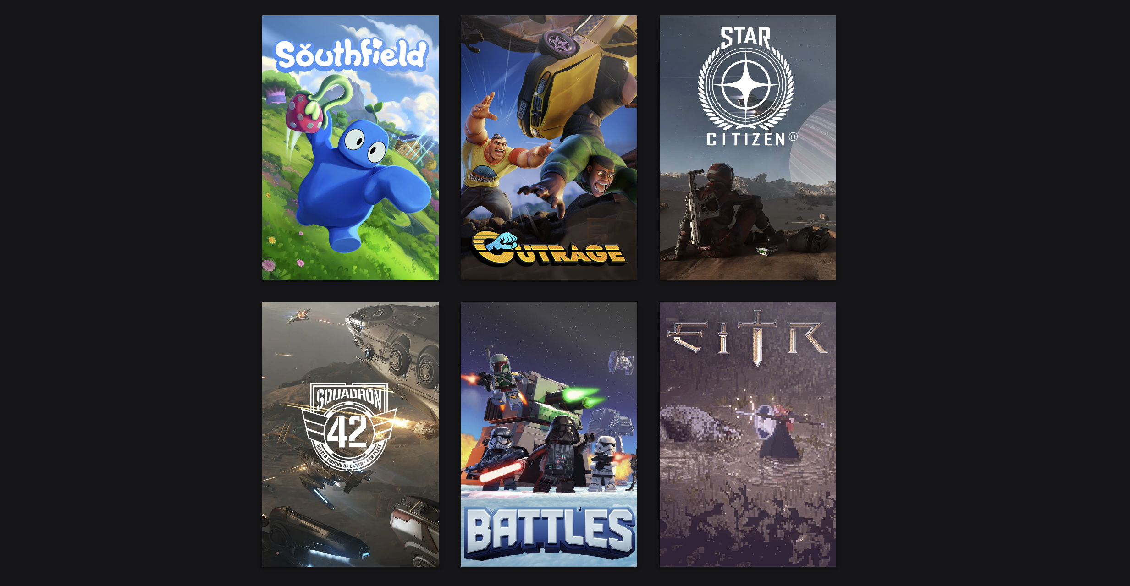
Notes:
Here are some of the games I’ve worked on for my career.
Eitr was the indie title I made working part-time at College with Devolver Digital.
This game unfortunately lost funding and never released, which is a shame.
To this day this is the only Devolver Digital title that was announced in such a public manor and never finished.
Everyone at Devolver knows Eitr as THAT game.
Then I worked on LEGO Star Wars Battles, a mobile clash-of-clans clone.
I made the game servers and many of the databases that make up the game.
Then, when I went to Cloud Imperium Games, I was working on both Star Citizen and Squadron 42.
Here I made lots of tools to manage the game data.
Then at Hardball I worked on a little title called Outrage.
And finally, what I’ve been doing for the last year and a half; working on a title at Radical Forge. I can’t say anything about the game unfortunately because the trailer releases on Wednesday; but this is the cover art that is public so I’m not breaking any NDAs.
I wish I could show you all the trailer because I actually made a lot of tools to enable the marketing team to record the trailer.

Slide 12
What do I do?
Notes:
What do I do?
I’m going to share with you what a normal interaction with a Tools Programmer might look like.
Along with how you as an Artist or a Designer might be connected with your local Tools Programmer or just programmers more generally.
But, to do that. I’m going to need an artist volunteer!

Slide 13
I need an artist volunteer!
Don’t be shy!
You will be required to paint shapes (nothing complicated).
I don’t anticipate that you will get messy, but I don’t want to upset the staff here at Northbrook, so I have taken every precaution by placing down a dust sheet to catch any paint that might make its way onto the carpet.
Notes:
I need an Artist as a volunteer.
I will need you to be able to paint shapes so it’s nothing complicated, but I am trying to tell a story about being an artist working in the industry.
Raise your hands if you're interested.

Slide 14
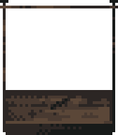
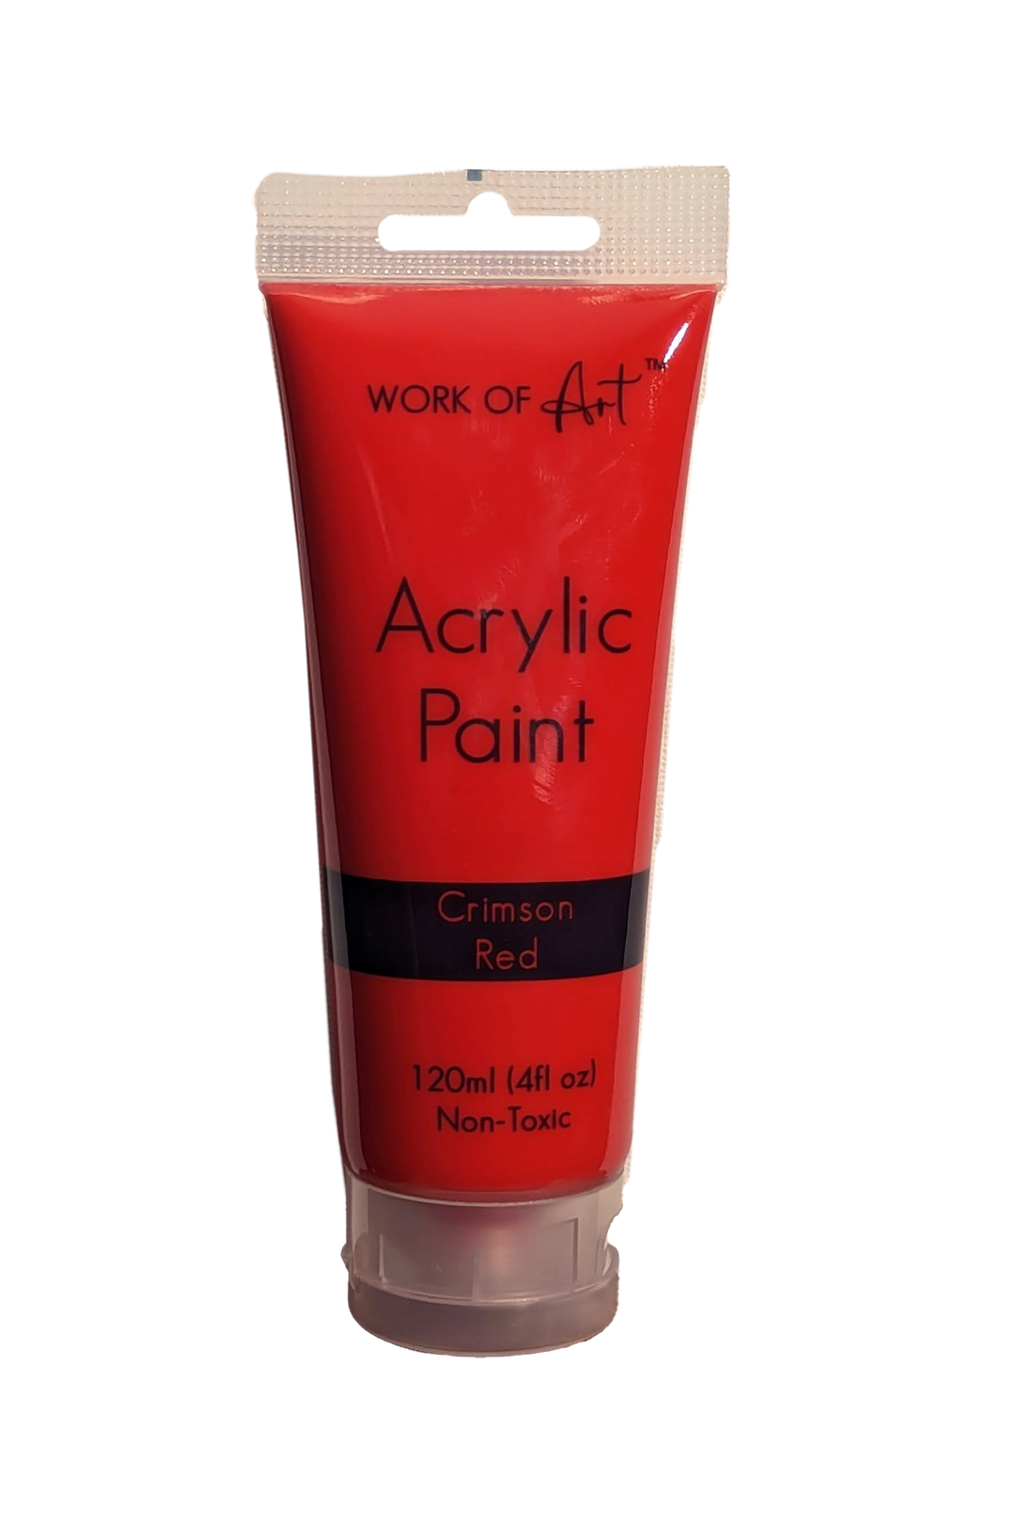

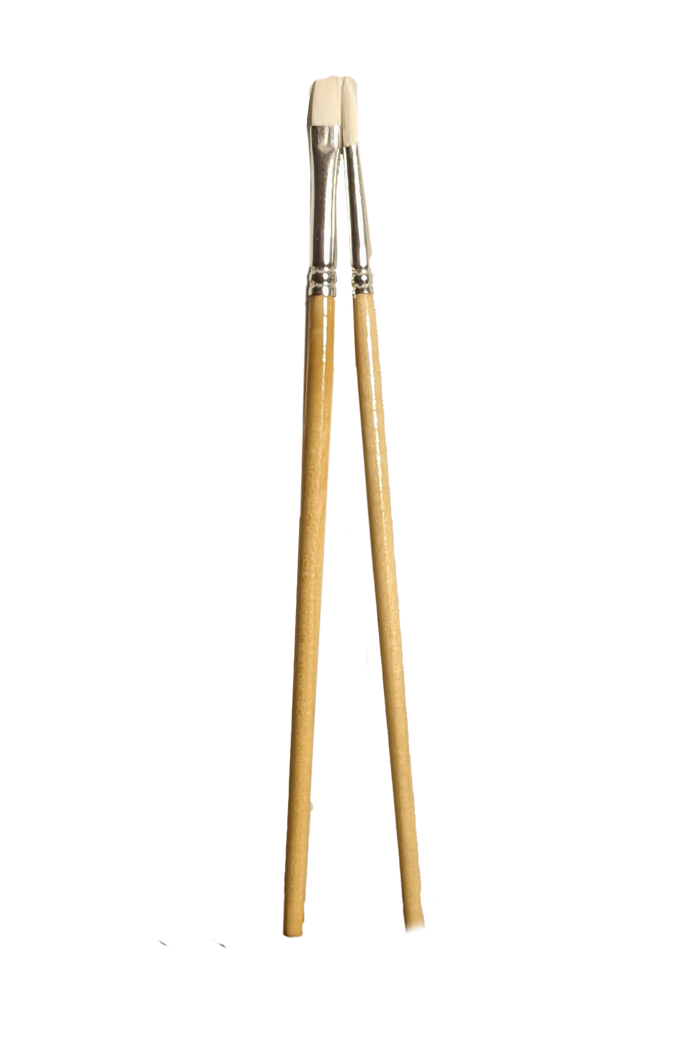
Notes:
Sooo… What do we have here?
Our brave artist volunteer has Infront of them…
In their inventory.

Slide 15
Notes:
Our brave artist volunteer has Infront of them…
In their inventory.

Slide 16
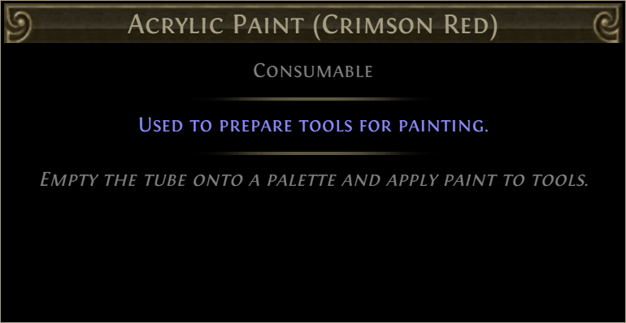
Notes:
Some Acrylic Paints, in Crimson Red, in that paint tray over there.

Slide 17
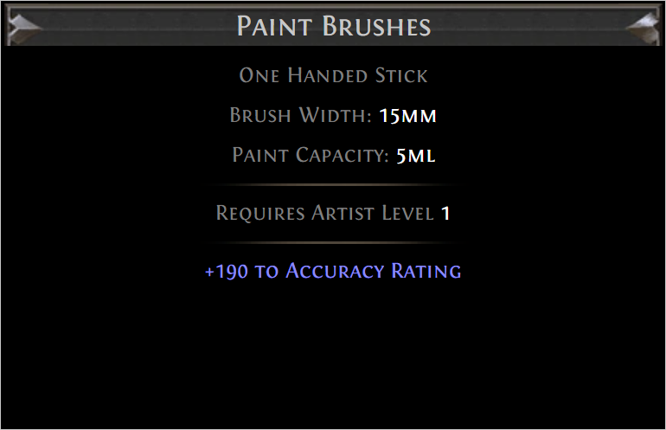
Notes:
And some Paint Brushes
Quite small brushes, probably more suited to delicate detail work than anything else.

Slide 18
Notes:
So, let’s begin!
You, brave artist, has just got their first job in the industry. Congratulations!
Today you are going to meet your team.
Here we have your DESIGNER.

Slide 19
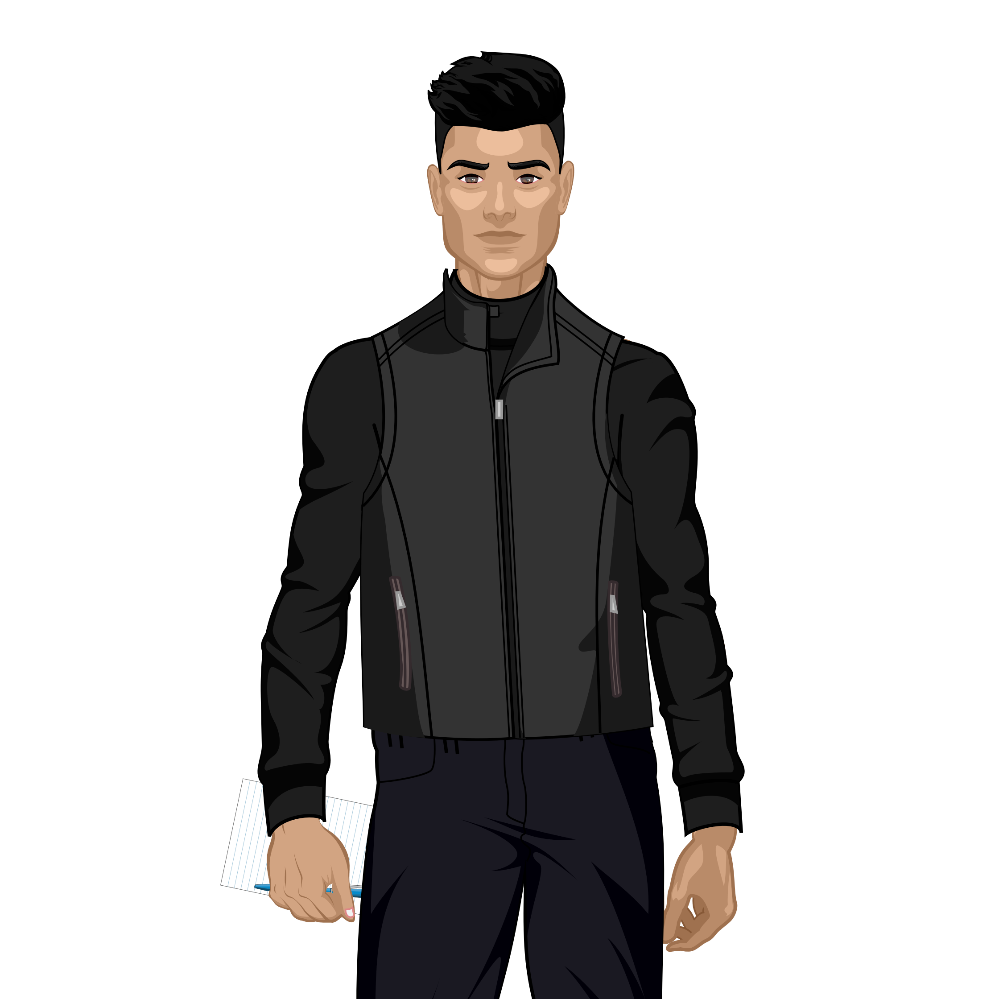
DESIGNER
Yo! Welcome to the team!
I’ve got your tasks right here.
Notes:
Here we have your DESIGNER.
You’re going to have to work with them to get the specifications for the work your about to do.
The DESIGNER says:
Yo! Welcome to the team!
I’ve got your tasks right here.

Slide 20
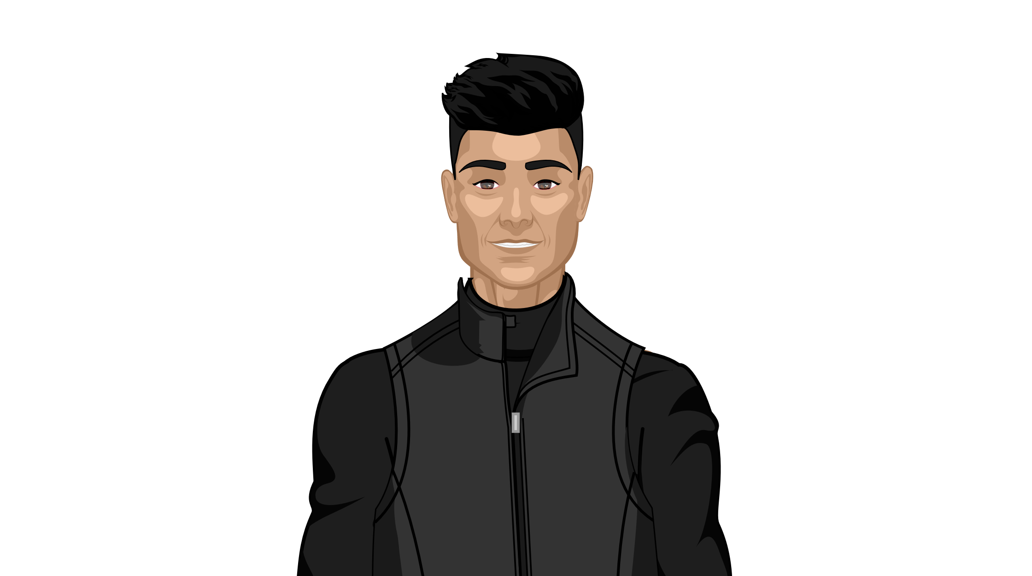
DESIGNER
If you need help with anything, be sure to let either myself or THE PRODUCER know.
Notes:
The DESIGNER says:
If you need help with anything, be sure to let either myself or THE PRODUCER know.

Slide 21
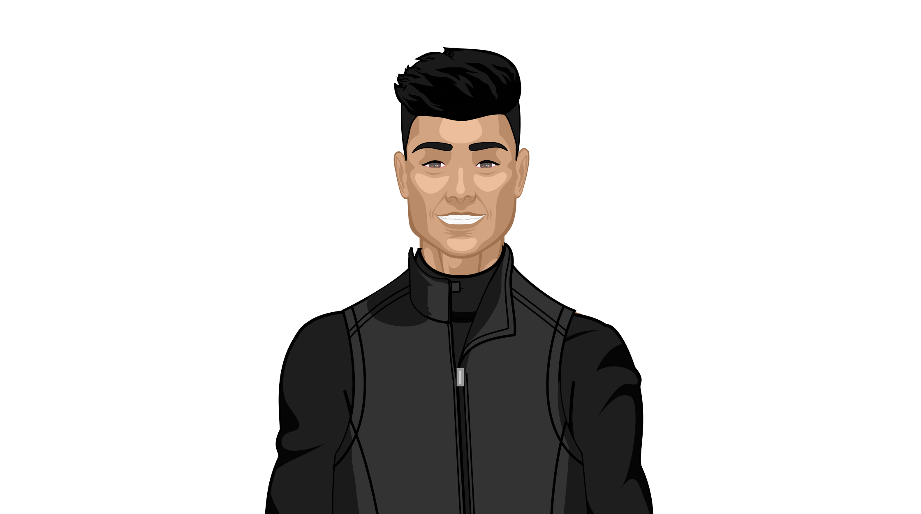
DESIGNER
I need you to paint me a RED SQUARE, approximately 2cm x 2cm. Anywhere on the canvas will be fine.
Notes:
The DESIGNER says:
I need you to paint me a RED SQUARE, approximately 2cm x 2cm. Anywhere on the canvas will be fine.
WAIT UNTIL A RED SQUARE HAS BEEN PAINTED.
Designer: “I think the players are really going to vibe with the RED SQUARE”
Designer: “I’m so stoked about this RED SQUARE.”
Designer: “It’s gonna have 4-corners, and it’s gonna have 4-edges.”

Slide 22


DESIGNER
That’s great! I love
Notes:
The DESIGNER says:
That’s great! I love RED SQUARE.

Slide 23
DESIGNER
Can you paint me 1 MORE
Notes:
The DESIGNER says:
Can you paint me 1 MORE RED SQUARE.

Slide 24
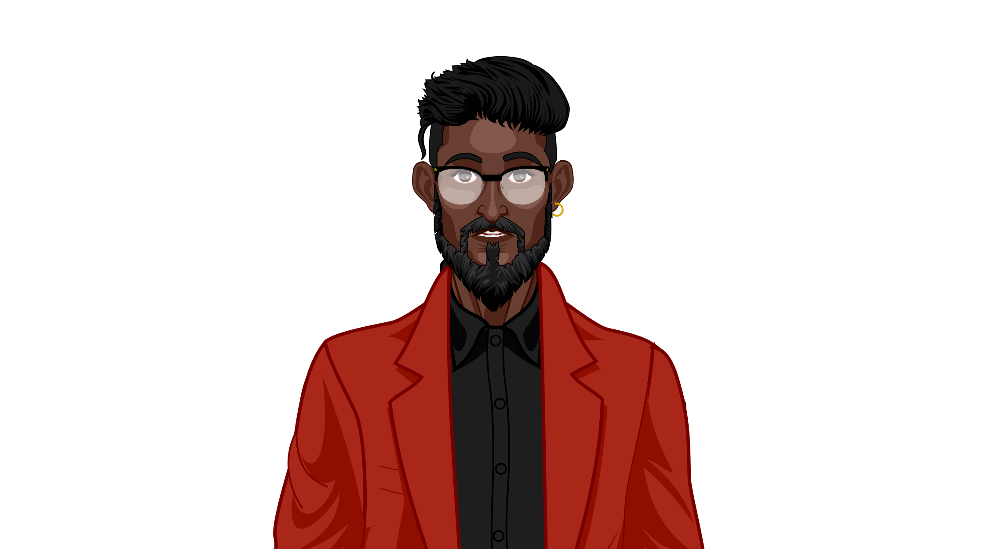
PRODUCER
How long do you think it will take you to paint 1 MORE RED SQUARE?
Notes:
Hello Producer:
The producer asks
How long do you think it will take you to paint 1 MORE RED SQUARE?
Good Question.
We’ve done it once before so… no longer than it took us the first time.
Maybe even a slight bit faster as we’re getting more proficient at producing RED SQUARE.

Slide 25
PRODUCER
Alright, get to it. If you encounter any delays, then let me know and I’ll get the TOOLS PROGRAMMER to see if they can help you.
Notes:
Alright, get to it. If you encounter any delays, then let me know and I’ll get the TOOLS PROGRAMMER to see if they can help you.
It’s important to let this guy know as soon as possible if the task is going to start to overrun, as it’s this guy's job to make sure the project is running on track and that you have all the support you need.
WAIT UNTIL THEY PAINT ANOTHER RED SQUARE.
Awesome work, we now have 2 RED SQUAREs.

Slide 26
DESIGNER
Let’s say we paint 12 MORE
Notes:
The designer then tells you that we are now going to be painting 12 MORE RED SQUARE.

Slide 27
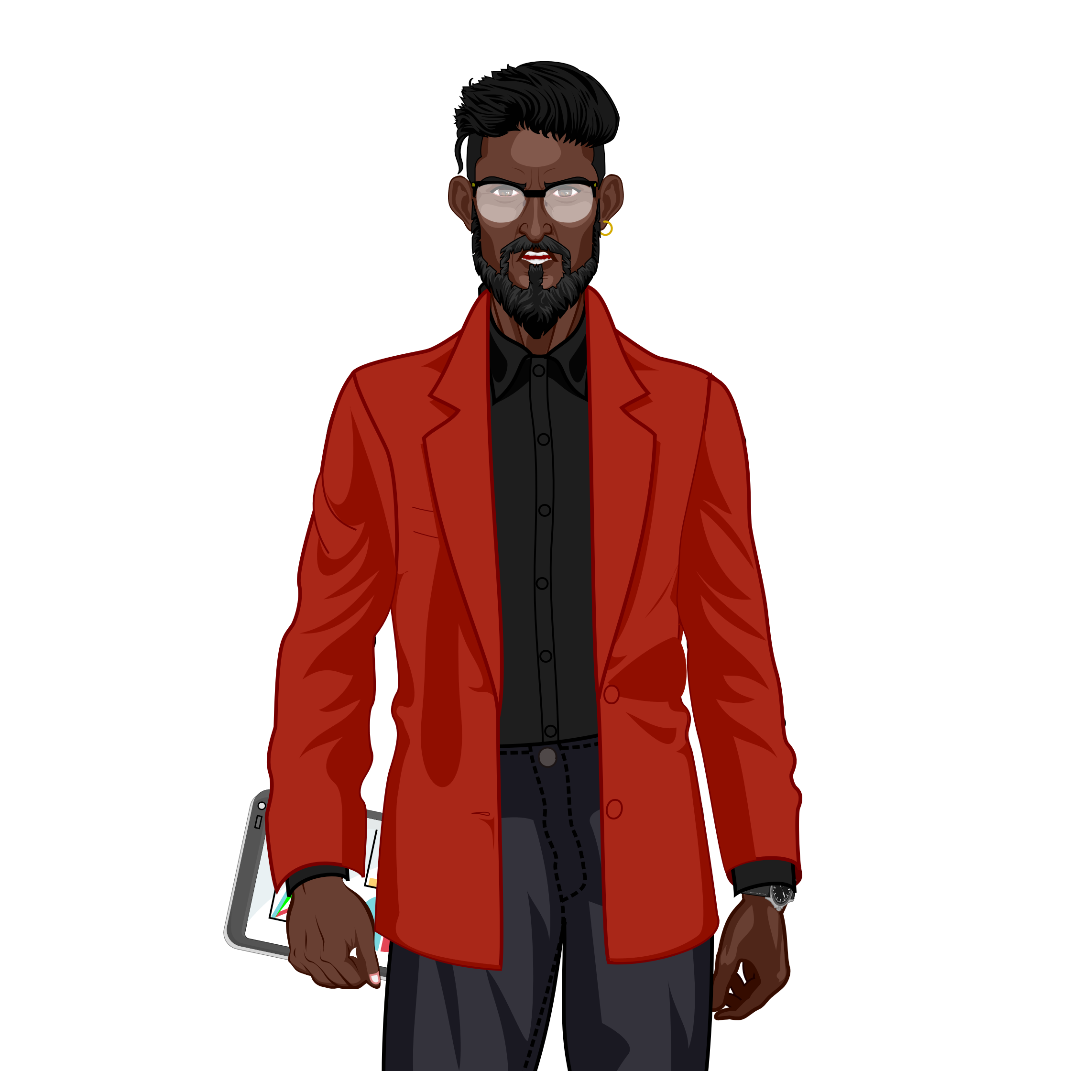
PRODUCER
Woah! 12 MORE RED SQUARE?!?! That’ll take way too long!
Notes:
And here comes the Producer, saying
Woah! 12 MORE RED SQUARE?!?! That’ll take way too long!
So, the Producer comes to the Tools Programmer and asks…

Slide 28

Hay, TOOLS PROGRAMMER.
Have you got anything to make this easier?
PRODUCER
Woah! 12 MORE RED SQUARE?!?! That’ll take way too long!
Notes:
So, the Producer comes to the Tools Programmer and asks…
Hay, Tools Programmer.
Have you got anything to make this easier?

Slide 29
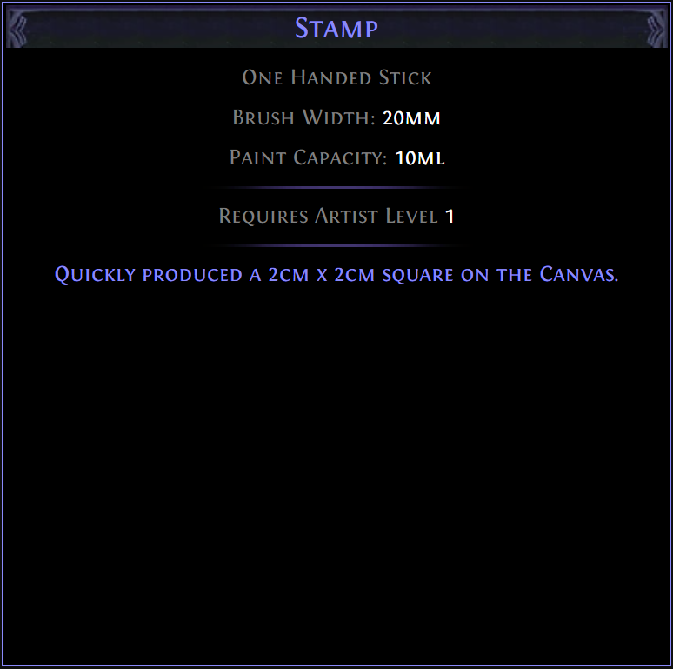
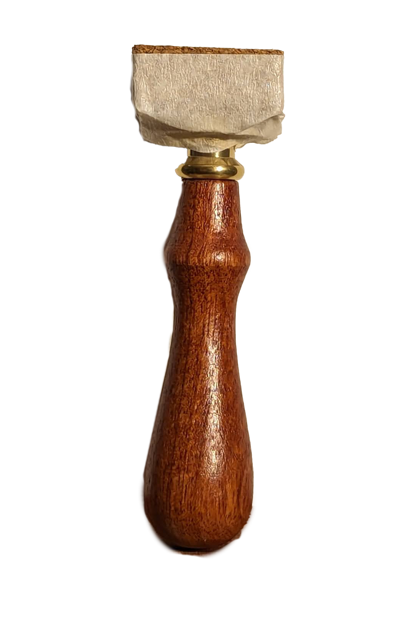
You received a [Stamp]!
PRODUCER
Woah! 12 MORE RED SQUARE?!?! That’ll take way too long!
Notes:
And… As a matter of fact… I do!
The Tools Programmer can create bespoke tools to suit the game.
And now here’s a tool I produced to perform one task very well.
The STAMP.
With the Stamp we’re going to be able to quickly produce RED SQUARE.
Or at least… I hope…

Slide 30
> Yes
No
PRODUCER
With your new tools, do you think you will be able to complete 12 MORE RED SQUARE in under a minute?
Notes:
So, now that you are equipped with your new tool,
the Producer asks whether you think you will be able to complete 12 MORE RED SQUARE in under a minute?

Slide 31
PRODUCER
Okay, get to it! Remember to communicate regularly with THE DESIGNER to make sure we stay focused on producing the best RED SQUARE we can.
Notes:
Whilst you as an artist are producing; you will be in constant communication with the Designers to make sure your art is fit for its gameplay purpose.
And remember, as always, if you encounter any unexpected delays, you’ll have to communicate them to your Producer.

Slide 32
Notes:
So, let’s get painting some RED SQUARE.

Slide 33
DESIGNER
Hay! How’s it coming?
Notes:
The DESIGNER says:
Hay! How’s it coming?

Slide 34
DESIGNER
Sweet work! I’m loving the
Notes:
The DESIGNER says:
Sweet work! I’m loving the RED SQUARE.

Slide 35
DESIGNER
Can you give me some more, but with VARIOUS ROTATIONS?
Notes:
The DESIGNER says:
Can you give me some more, but with VARIOUS ROTATIONS?

Slide 36
DESIGNER
…
Notes:
…
Hmm…
…

Slide 37
DESIGNER
Somethings not quite right… Maybe we’ve been thinking about this all wrong.
Notes:
The DESIGNER says:
Somethings not quite right… Maybe we’ve been thinking about this all wrong.

Slide 38
DESIGNER
QA have said that users are having issues with RED SQUARE. How about we try something new.
Notes:
The DESIGNER says:
QA have said that users are having issues with RED SQUARE. How about we try something new.

Slide 39
DESIGNER
Can you produce me 1 RED CANVAS. Entirely red. The whole thing.
Notes:
The DESIGNER says:
Can you produce me 1 RED CANVAS. Entirely red. The whole thing.

Slide 40
PRODUCER
DESIGN HAS ASKED FOR WHAT?!?!?! A RED CANVAS?
Notes:
The PRODUCER shouts:
DESIGN HAS ASKED FOR WHAT?!?!?! A RED CANVAS?

Slide 41
Hay, TOOLS PROGRAMMER.
Can you make a tool to make this easier?
PRODUCER
DESIGN HAS ASKED FOR WHAT?!?!?! A RED CANVAS?
Notes:
So, the Producer comes to the Tools Programmer and asks…
Hay, Tools Programmer.
Can you make a tool to make this easier?
So then I might sit down with the artist and we’ll come up with a plan for a tool.
If there are any compromises that have to be made then we’ll negotiate them with the Designer.

Slide 42
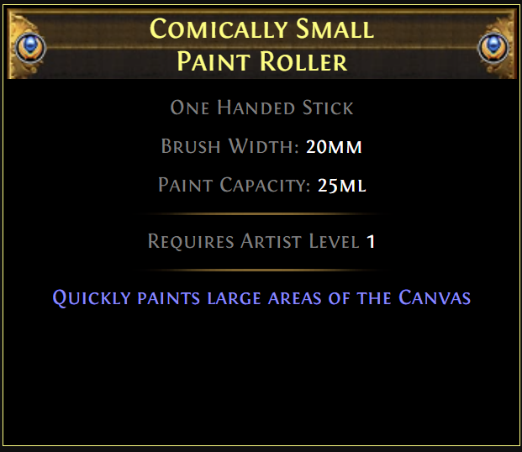
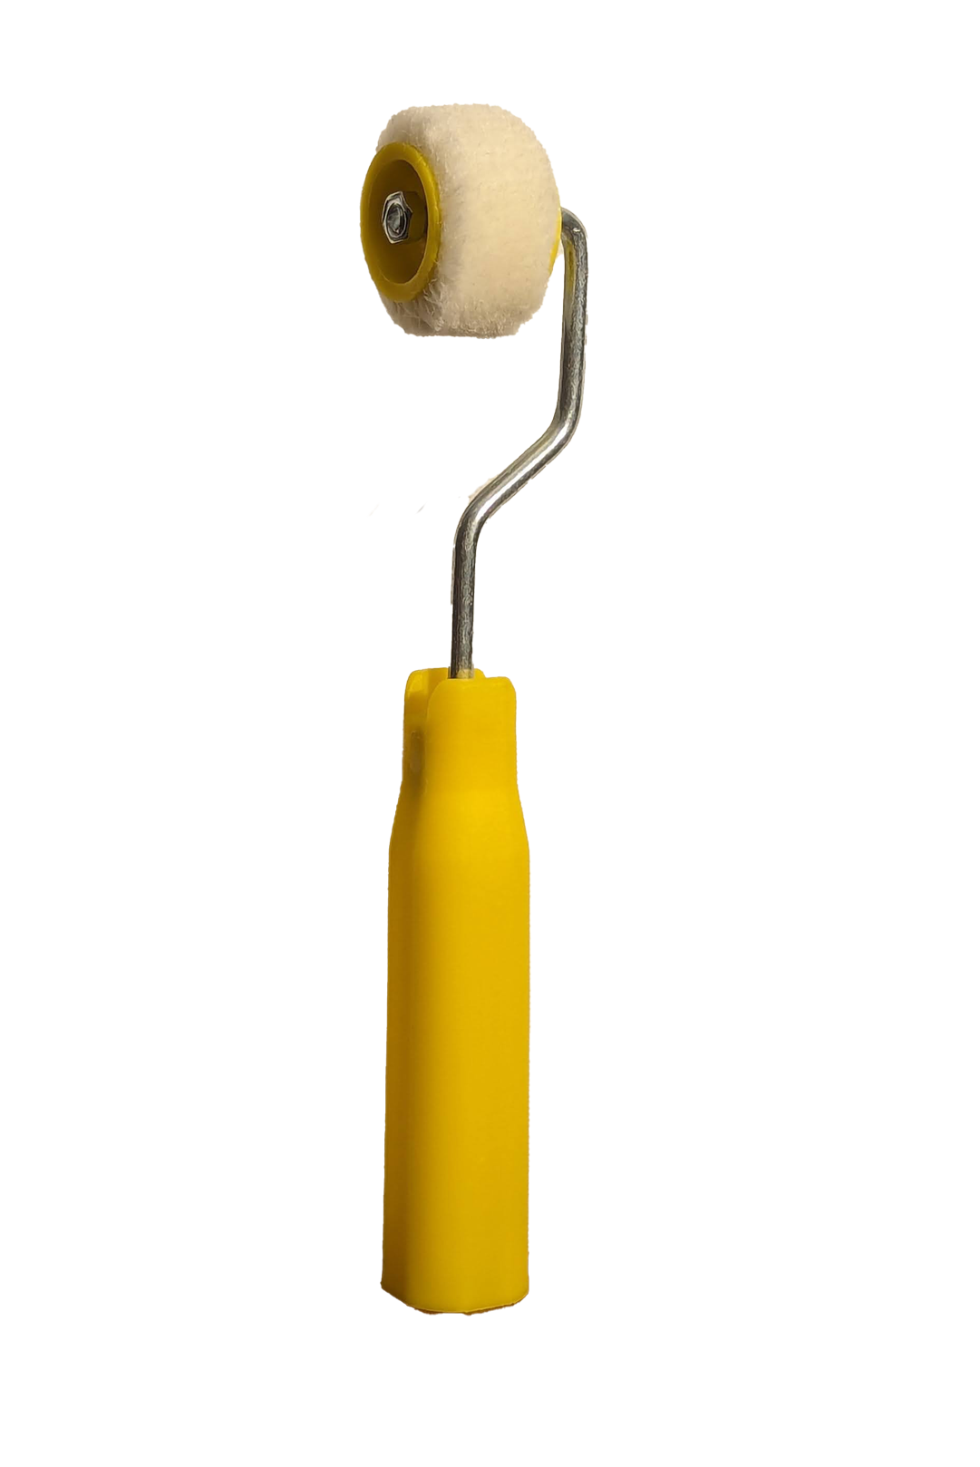
You received a [Comically Small Paint Roller]!
PRODUCER
DESIGN HAS ASKED FOR WHAT?!?!?! A RED CANVAS?
Notes:
And… As a matter of fact, I can make that tool!
Here we have it!
The Comically Small Paint Roller.
So… How about you give it a go.

Slide 43
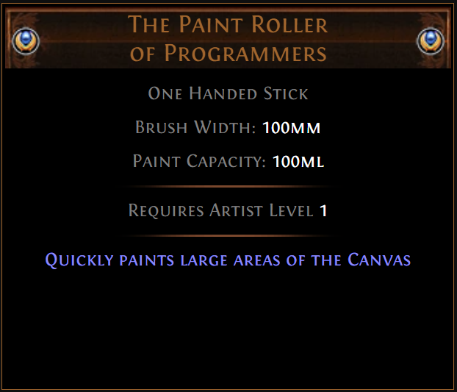
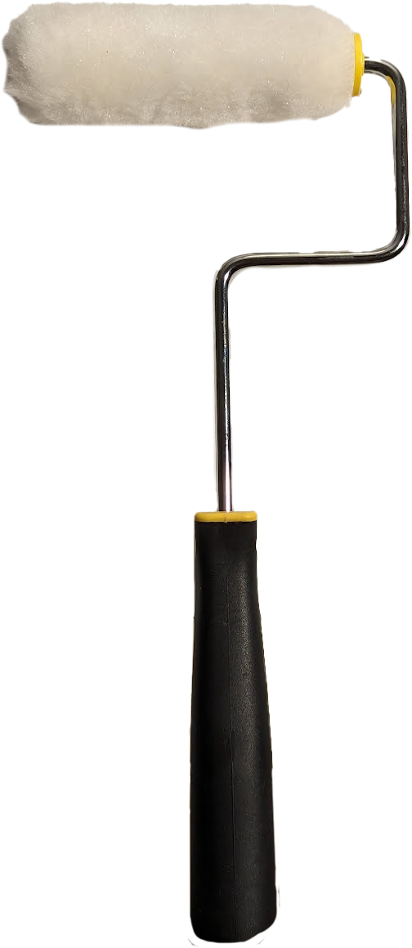
You received a [The Paint Roller of Programmers]!
PRODUCER
DESIGN HAS ASKED FOR WHAT?!?!?! A RED CANVAS?
Notes:
Hmm… If I was to tweak the tool I gave you to make it 5 times bigger, would that help?

Slide 44
DESIGNER
Awesome work!
Although I’m starting to think we should try another colour...
Notes:
The DESIGNER says:
Awesome work!
Although I’m starting to think we should try another colour...
As is always the way with games development. But fortunately, we now have the tools to make that possible.

Slide 45
Take a bow!
And perhaps a round of applause for our artist?
Notes:
Take a bow!
Congratulations on your first day in the industry!
Just place the tools in the bin bags and I’ll get them cleaned up when I get home.

Slide 46
That was a lot of fun, but…
Notes:
How does this all relate to what I do?
Well, as the Tools Programmer, I craft bespoke tools to suit the needs of the artist.
And as a Tools Programmer, I have a lot of influence in the creative process.
I often work very closely with the artists so I can anticipate their needs or identify other pain points in their workflows.
If my artists had maybe a Spray Paint can for example; they could easily change colour without having to wait for it to dry on the canvas.
Which would enable a whole new dimension of creativity.
But was all of this just to say that:
You need tools to do things…
Of course, we all know that.
This so far has been a very abstract metaphor; so, let’s bring it back to something a little more concrete.
And actually, show you some of my work.
Now I can’t show you the latest versions of the tools, but I can show you the tools that I have made for my own personal consumption outside of work.

Slide 47
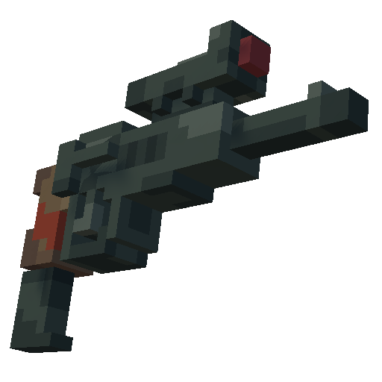




The Problem
Production
Notes:
An example from my recent work has been generating icons for our game.
When prototyping our game, our artists screenshotted the 3D models, removed the background, and crop it to be square.
This is fine for a couple of items; but when those items change a lot, the artists have to keep going back and updating the icon.
Sooo… We can automate that!

Slide 48
The Bodge
Notes:
And so we did just that, we added a button to take a screenshot and save it to a file.
But even that started to prove a problem.
Whenever we needed a new icon I would need to open the tool, select the item we needed to generate an icon for, reposition it if needed, and then save it out to the right file.
So when the game had HUNDREDS of icons that we needed to change; it’s time for a new tool.

Slide 49
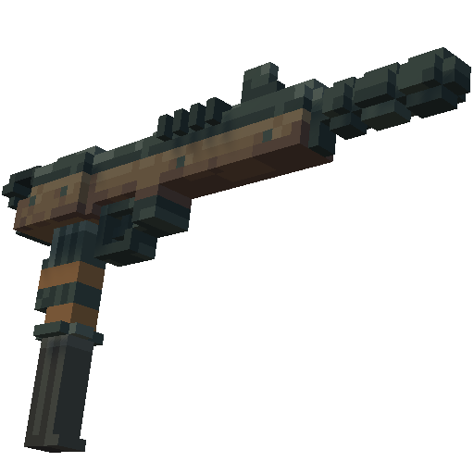
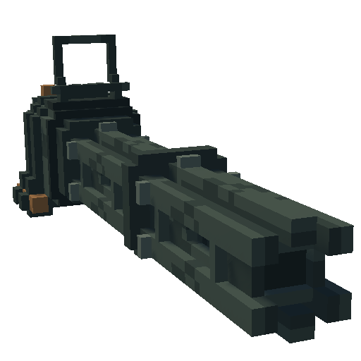
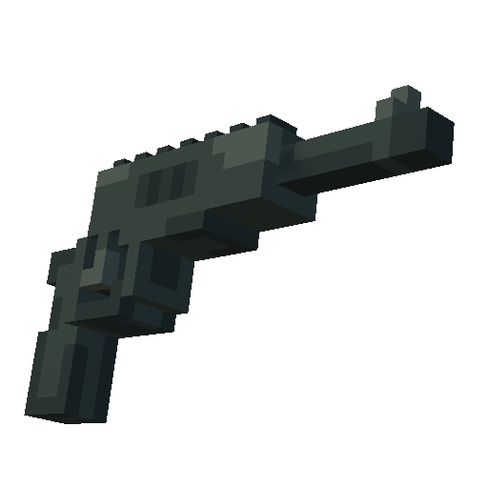
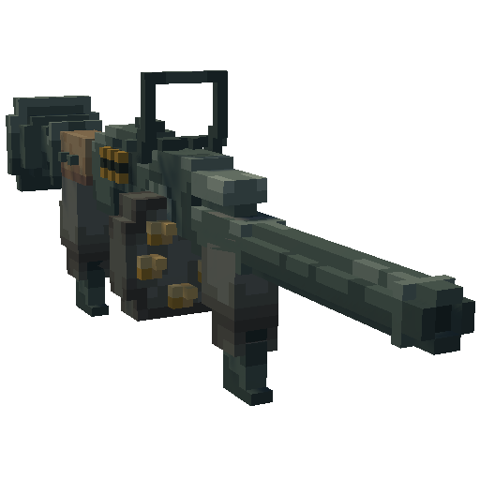
The Solution
Notes:
I initially created this tool, Holodrone, for my personal project; but when my artists started to have difficulties with their current workflow, I imported it and customized it for our specific needs.
One of these specific needs was to add a drop shadow behind all of the icons, which greatly improved the UI.

Slide 50
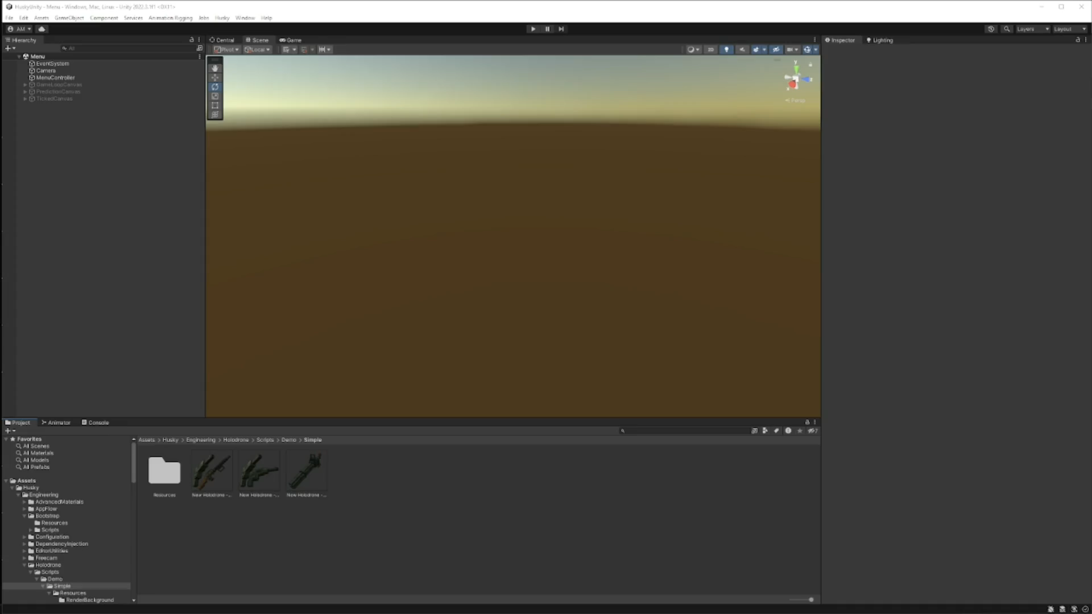
Notes:
Here’s the tool that I made to solve this icon problem.
As you can see, I have a couple of icons prepared already.
Some little Voxel Art guns in my Unity Project window.
If I double-click on one of these, we’ll see that it opens up the diorama that the icon renders in the scene view.
I can edit everything about the icon in 3D. I can move the camera around. I can add another prop.
From there, I have a before and after on the icon so I can compare to see what my changes look like on the final icon.
This is a non-destructive workflow; which means that if I want to go back and change something, like the environment lighting, I can.

Slide 51
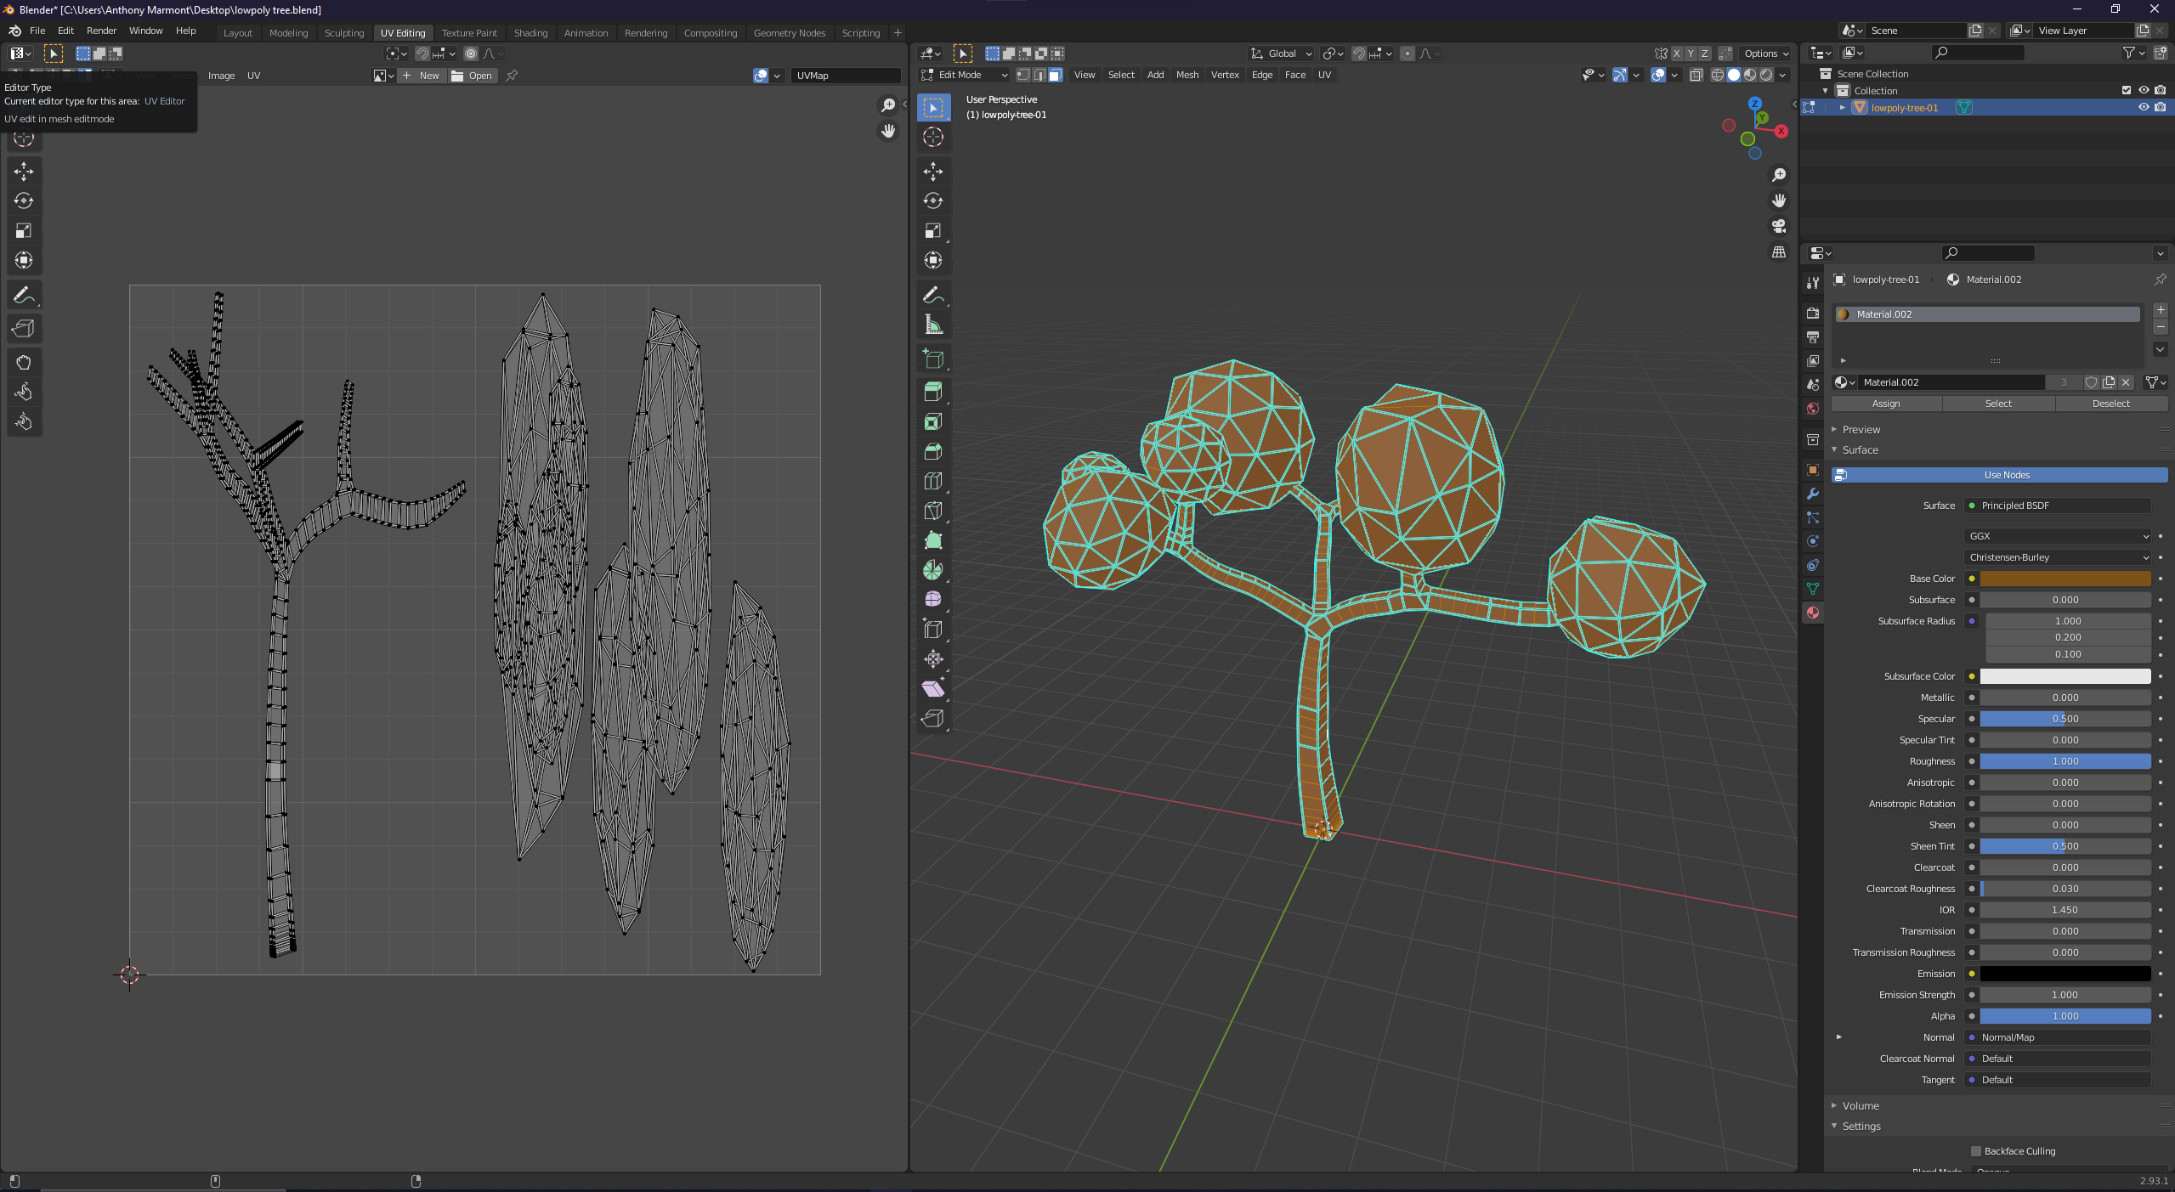
The Problem
Notes:
Have you all seen models that are UVed like this one here?
These are models that are designed to be textured using a texture containing one or more vertical gradients.
On this tree that I have up on the screen, the LEFT side of the UV space is dedicated to the trunk of the tree and the RIGHT side of the tree is dedicated to the leaves.
Show of hands for people who understand this workflow for creating assets??
Well if you don’t understand what I mean here then it might become clear soon when I show the tool in action.

Slide 52
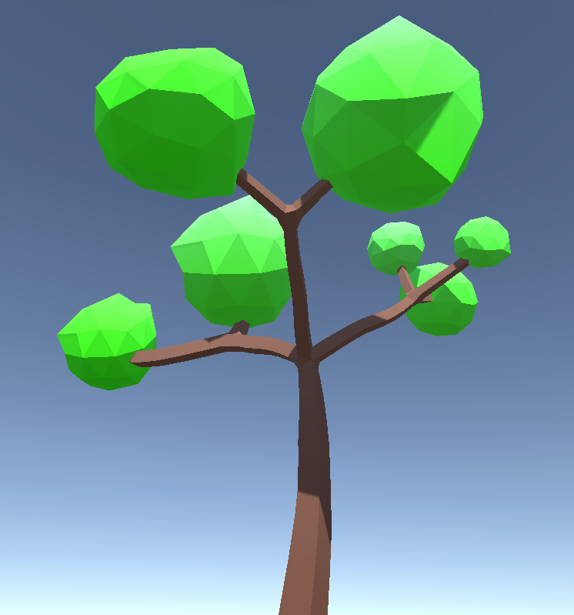
The Problem
Production
Notes:
When creating the gradients used to texture the tree, I found that our artists created them using Photoshop.
And to do so they would go back-and-forth between Photoshop and Unity over and over and over again.
As before; this is fine when we are working with one asset; but once you have HUNDREDS????
Then it becomes a problem; as it did at Radical Forge.

Slide 53
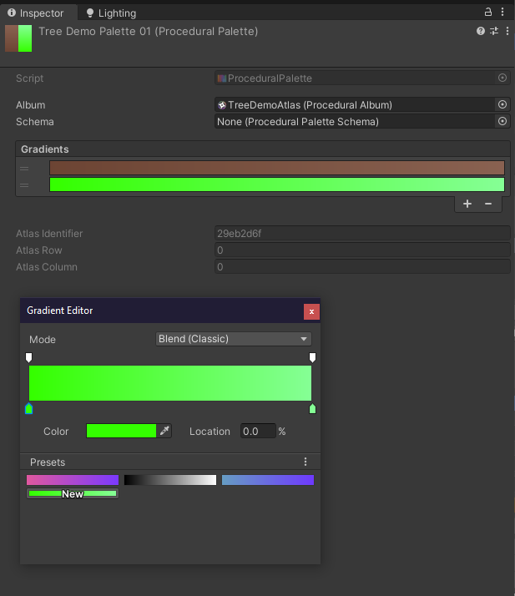
The Solution
Notes:
The solution is more BESPOKE TOOLING!
Here’s a tool I made and remade and remade so many times because it’s so useful.
This tool basically gives us the Unity Gradient Editor for textures, which saves us the constant back-and-forth between Unity and Photoshop.
And allows us to edit the gradients directly in the editor.

Slide 54
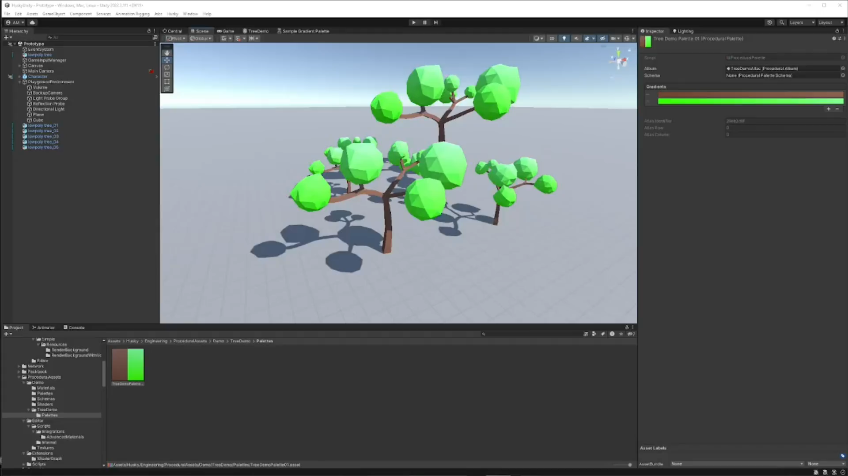
Notes:
Here’s a video of the tool in action.
The artists got so excited when I unveiled the tool to them. They were literally buzzing with excitement.
Here’s a video of my changing the gradient right inside the editor.
I’m going to be turning these oak trees into a cherry tree.
As you can see, as I edit the gradients, they update in realtime.
This allows the artists to make rapid iterations and experiment with colours faster, and saves them from having to go between Photoshop and Unity to make the gradients.
It’s also a lot easier to manage the gradients when they are these simple gradient assets.

Slide 55
So, that’s what I do.
Notes:
As I mentioned at the start, I also do Server Infrastructure and Multiplayer engineering, if you wish to ask me any questions about them at the end.
How are we for time? Let’s see…

Slide 56
Proud Member of the
IWGB Games Workers
Notes:
Unions can help massively.
74% of game workers are not paid overtime, but 90% can be expected to work extra hours.
53% of game workers believe that their skillset could secure better wages and conditions in another industry.
45% of women feel they have or will at some stage encounter barriers to their career progression because of their gender.
45% of women have experienced some form of bullying or harassment whilst working in games or by being associated with the industry.
Two thirds of games companies (worldwide) do not have mechanisms in place to deal with harassment or abuse.

Slide 57
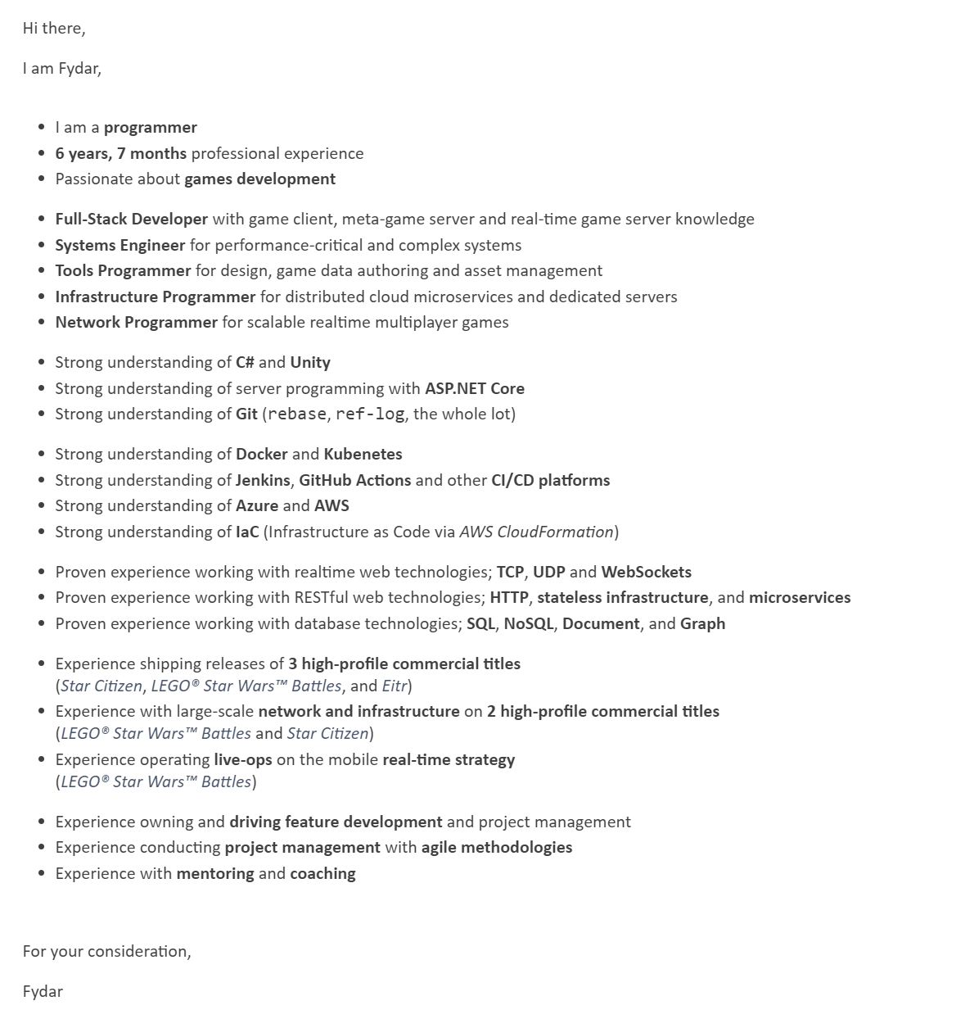
My Cover Letter
Tailored to the job posting.
Experiment and find out what works for you. Everyone has unique experience.
Notes:
And finally, some advice.
I have seen a lot of resumes now.
I’ve highlighted a lot of the same words.
From my experience, something like is pretty helpful. This is what my cover-letter now looks like. It’s everything that I would sit down and highlight right on the front.
Since it’s my cover letter, I can also tailor some of the key points to the job from the job posting.
And I know there’s no risk of someone missing something when they go through with a highlighter.
Almost every time I’ve handed in this CV; I’ve got a response; but this is still very-much work in-progress stuff for me.
You have to experiment and find what works best for you.
My biggest piece of advice when it comes to CVs: DON’T RATE YOUR SKILLS. Don’t do fancy bars or stars where you rate your skills our of 10 or whatever. Just don’t do it.
There is no way that you can come out of rating your skills looking good.

Slide 58
Questions?
You can find this presentation at
fydar.github.io/careers-2024.pptx
Fydar
(they/them)
Fydar
Proud Member of the
@Fydarus
IWGB Games Workers
Notes:
Unfortunately, I don’t know any inside details from ‘Star Citizen’.
If you follow the Reddit, you know more than me.
I find out about new planets being released by Googles News.

Slide 59
Thank you.

